Slide 1
PDI Feather tracking
Weighting machine & label printer

Slide 2
Development environment setup
Prerequisite program
Git Bash
Bartender Software (*important)
MySQL v8.0.32, Visual Studio Code, Visual Studio 2022, Node.js
Good to have: Hercules

Slide 3
Development environment setup
Open PDI_Feather_Tracking_API
Build the project.
Open Package Manager Console and run command: Script-Migration
This command will generate sql script to do migration.
Open MySql Workbench.
Create a database, Name : feather_tracking
Open the script generated before, execute and the data should be seeded into the database.

Slide 4
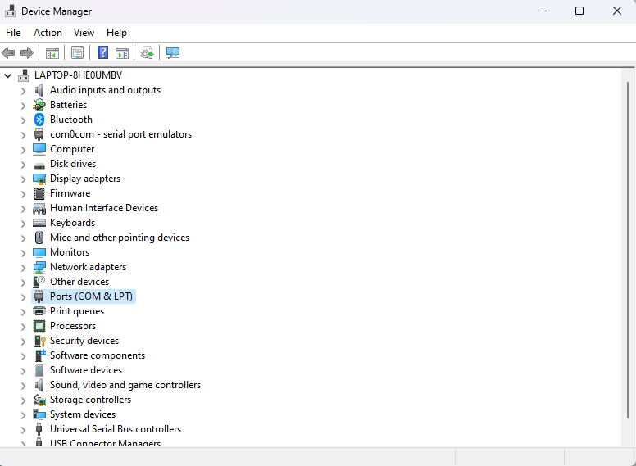
Program settings
Open PDI_FEATHER_TRACKING_WPF project, build the project as debug mode, search for appsettings.json.
Configure the printer name as the same shown in Windows printer utility.
Configure the Serial port connection properties of the weighting machine. The properties can be found in Device Manager > Ports

Slide 5
Program settings
Configure the label template path, logging path and report storage path.
Configure the database connection string to be the same as the database setup.
PrintService (0: disable, 1:enable)
WeightService (0:disable, 1:enable)
LogServicePort & PrintServicePort (change this if the port has been used for other purpose).
Program need to be restarted if the setting file has been changed.
Outbound Link (change this to the url pdi frontend web application)

Slide 6
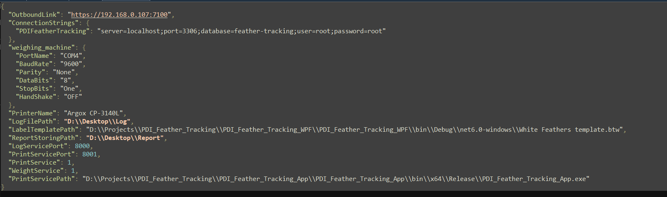
PROGRAM SETTINGS

Slide 7
Pdi feather tracking wpf
WPF program should automatically run printer service if the path is set correctly.
Login screen will be prompted (default password : abc123)

Slide 8
Main page
Menu bar
Logged in user
Change password
Logout
Tare weight setting - only able to modify by those having rights
Navigate to outbound url (set in setting file)
Main display of weight read from weighting machine, and selection of SKU type. Reprint functions if label fails to print, user can input the batch number and reprint the label.
Log record.
Saved record

Slide 9
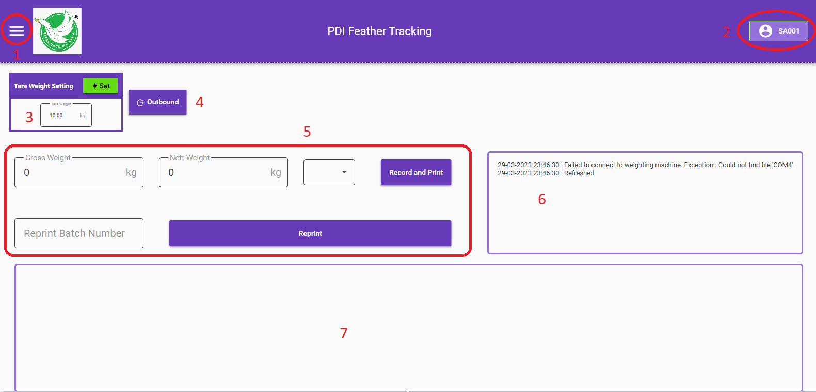
main page

Slide 10
report
Incoming date selection
Outgoing date selection
SKU type selection
Records which fullfill the condition being input.
Report generation.(Incoming, On hand balance, Weight List)
can be generated by container id or without.
container id will be filtered by filtered packages records.
Note:
Weight list report will only generate for those has been outbound.
If no condition being input, the system will show all record from the database.

Slide 11
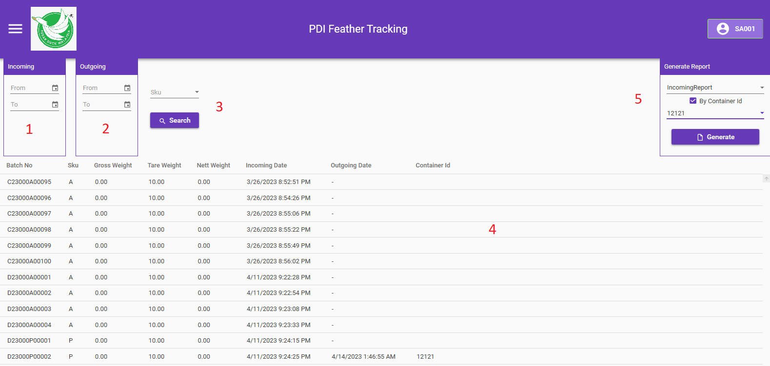
Report

Slide 12
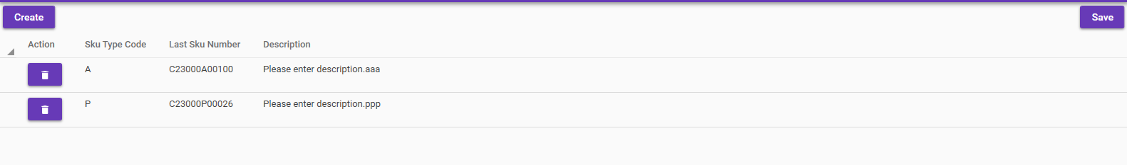
SKU type code
SKU type code and description can be modified by user.
Note that if SKU type code has been changed, the changes will not reflect to previous created package.
After creation/modification, remember to save to prevent data loss.
The description will be passed as label title.

Slide 13
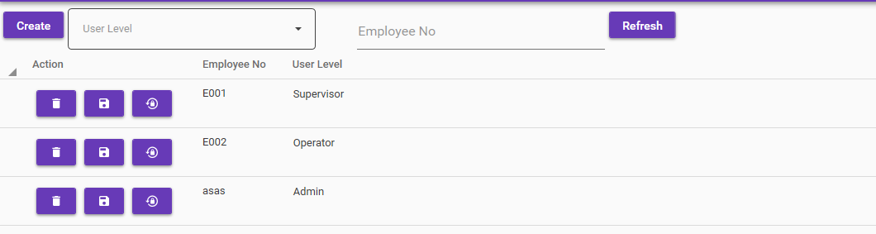
user
Top panel function:
create new user button
User level & employee filter
Reset the filter (Refresh) button
Employee no and user level can be modified, after modification, remember to save.
Delete and reset password button will prompt user for confirmation, if user does not respond, system will not modify the data.

Slide 14
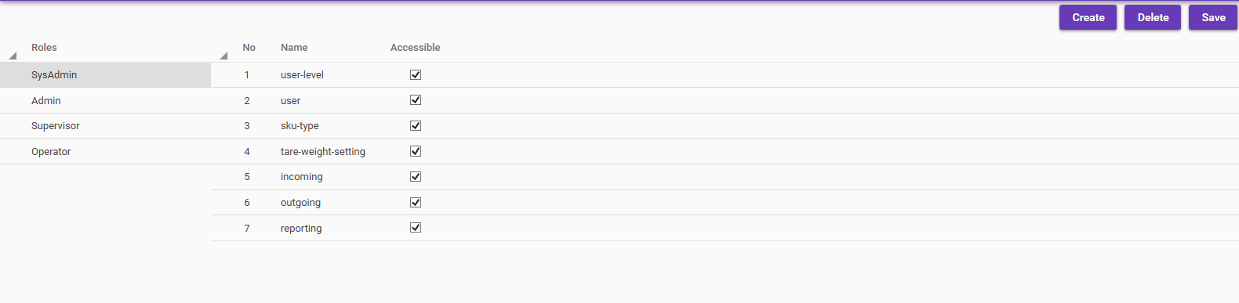
user level
User level should not be accessed other than system admin.
This is where the access for each module will be modify.
The modules cannot be changed or created, only the roles can be created and deleted, and the accessible rights of each role to each module can be modified.
Please save after modification to prevent data loss.

Slide 15
Pdi feather tracking app/ service
Uses TCP connection to connect to WPF application process data.
Uses .NET Framework 4.7 (Seagull DLL limitation)
Handles printing service and logging service, references the settings file in WPF application.
Modify configuration_folder_path inside file PDI_Feather_Tracking_App.exe.config refers for the file path of appsettings.json in WPF application.

Slide 16
PDI FEATHER TRACKING API
Act as database migration and web api.
Database migration uses Entity Framework Core Code First Approach.
Add-Migration MigrationName
Adds a new migration based on changes made on model classes and seeders
Update Database
Applies migration to database.
Remove-Migration
Remove last migration
Use sysadmin on first time login to setup user access module and create user.

Slide 17
Pdi feather tracking interface
VueJs progressive web application, vuex for token storage, fetch API.
Has to be run in https to get permission for using camera to scan QR, and for
Login user has to have permission for outbound.
Act both as mobile application and web application.
In order for vue to host on IIS, web.config file has to be created manually (refer to project hosted in test server)
Once QR code scan successfully, the package will be added to list displayed in table form.
User has to enter the container id in order to outbound.
If the packages passed contained invalid batch no or batch no has been outbound, the message will be displayed.

Slide 18
Pdi feather tracking interface
Outbound
Cancel Outbound
Update container

Slide 19
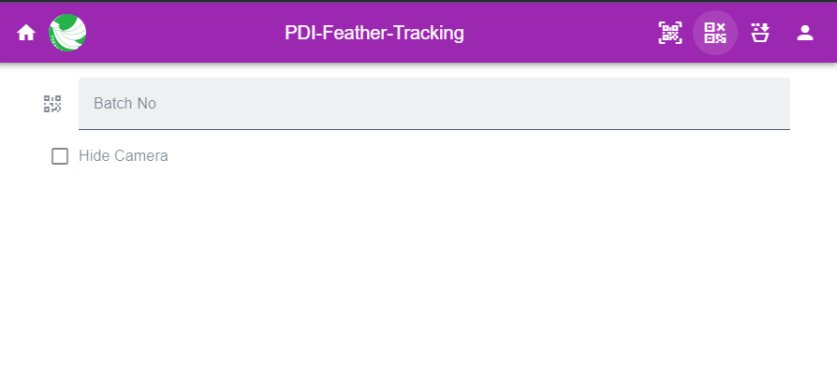
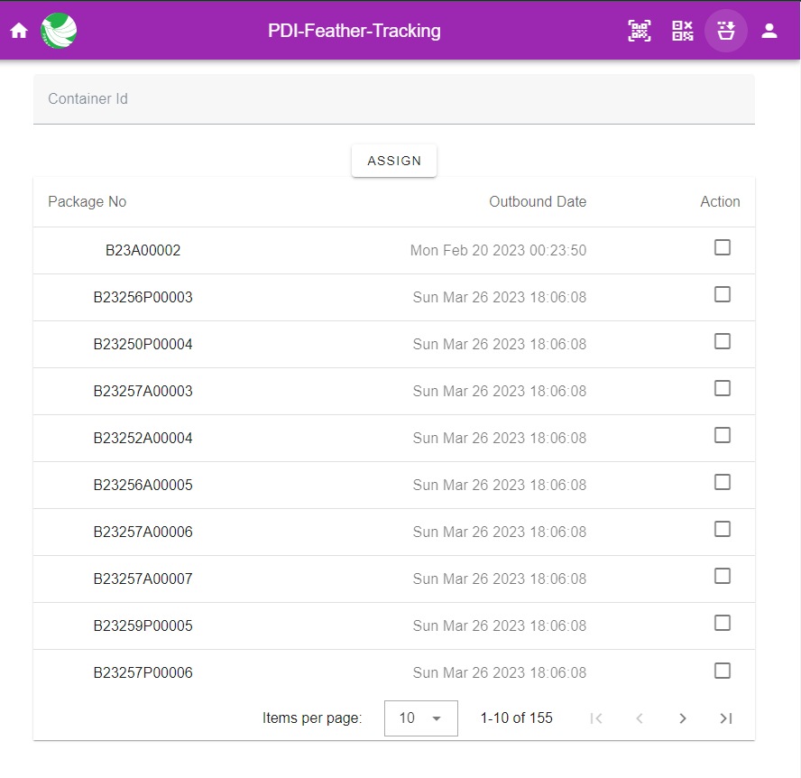
Pdi feather tracking interface
package cancellation module
update container module

Slide 20
appsettings.json (setting file)

